Slide 1
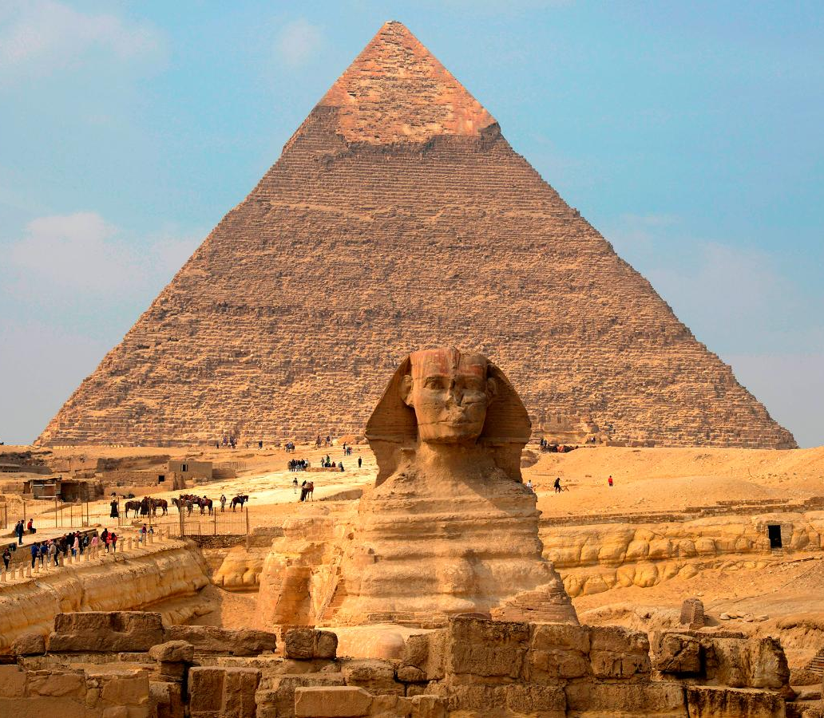
Egypt – Ancient Civilisations
GOAL/S: Identify and describe the Ancient Egyptian Civilisations
Week 7, Lesson 1

Slide 2
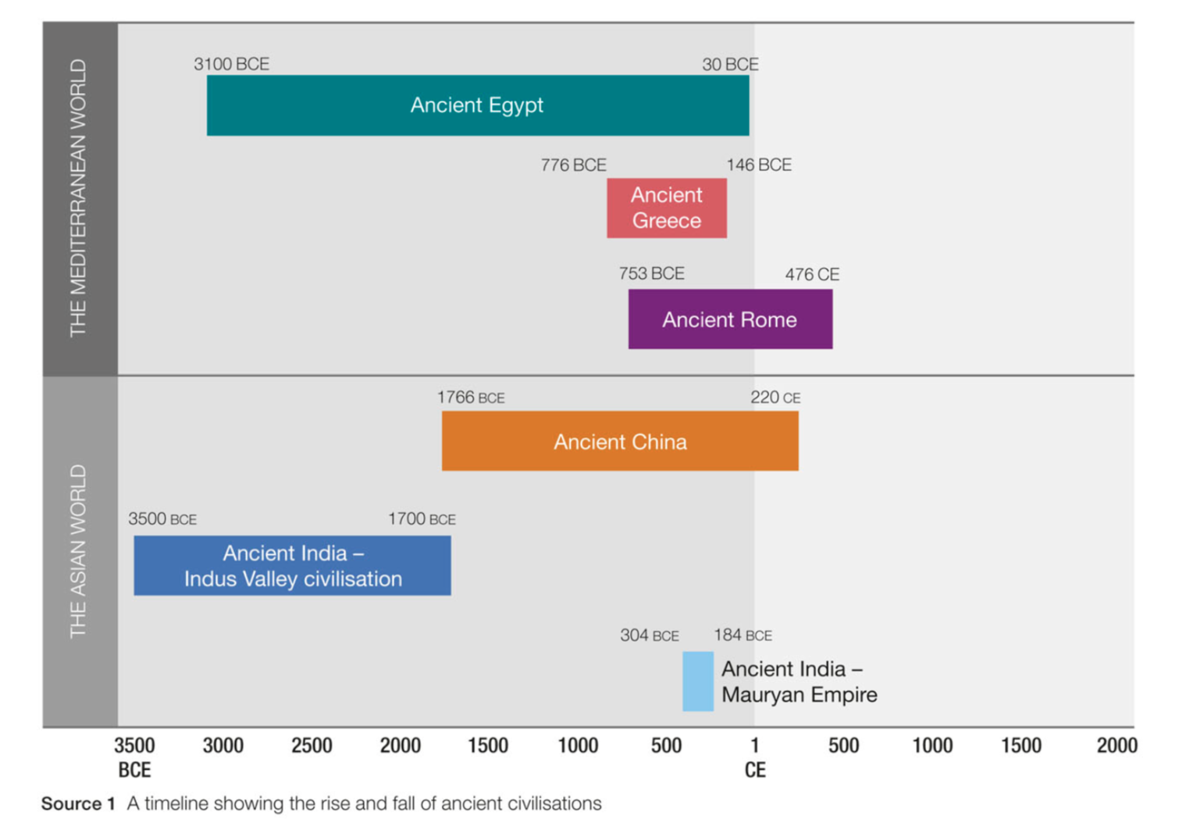

Slide 3
Watch the following:
https://www.youtube.com/watch?v=hO1tzmi1V5g&ab_channel=NationalGeographic

Slide 4
About 30000 years ago, the Sahara Desert of North Africa was a grassy plain. It began to dry out around 8000 BCE. This change in climate forced people in the region to move on. Many drifted towards the area next to the Nile River, where the land was more fertile and there was a good water supply. From this simple start developed one of the world's first civilisations - ancient Egypt. It lasted for nearly 3000 years. As the population grew, the society became more structured. Powerful rulers, called pharaohs, expanded Egypt's territory. Huge monuments, temples and pyramids were built that would last for thousands of years.

Slide 5
ACTIVITY Ancient Egyptian Periods
Using the information provided on each slide, fill in the info about the key Egyptian Periods

Slide 6
‘Dynasties’
Each dynasty is characterized by different rulers, political changes, cultural developments, and shifts in power, contributing to the rich tapestry of ancient Egyptian history.

Slide 7
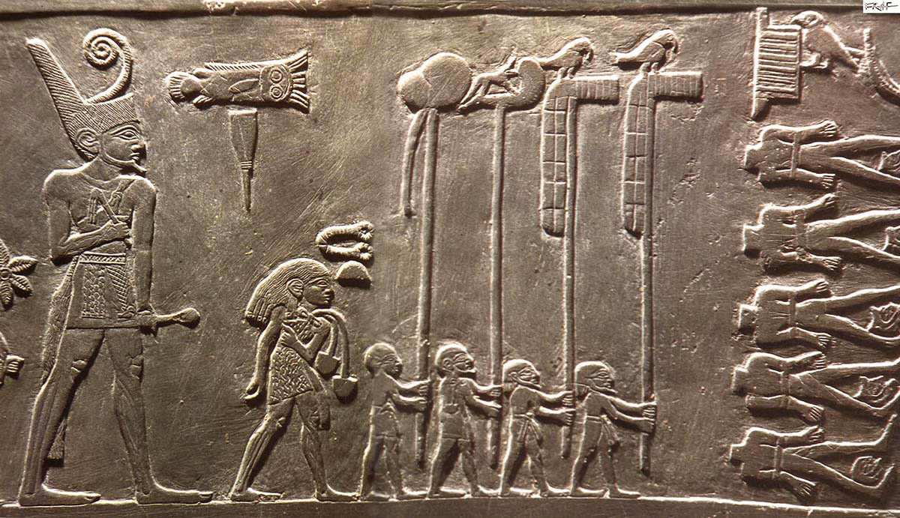
Predynastic Period (c. 6000–3100 BCE)
Characteristics: Formation of early settlements and development of agricultural practices along the Nile River.
Key Developments: Establishment of trade networks, emergence of distinct cultural regions, and advances in pottery and tool-making.

Slide 8
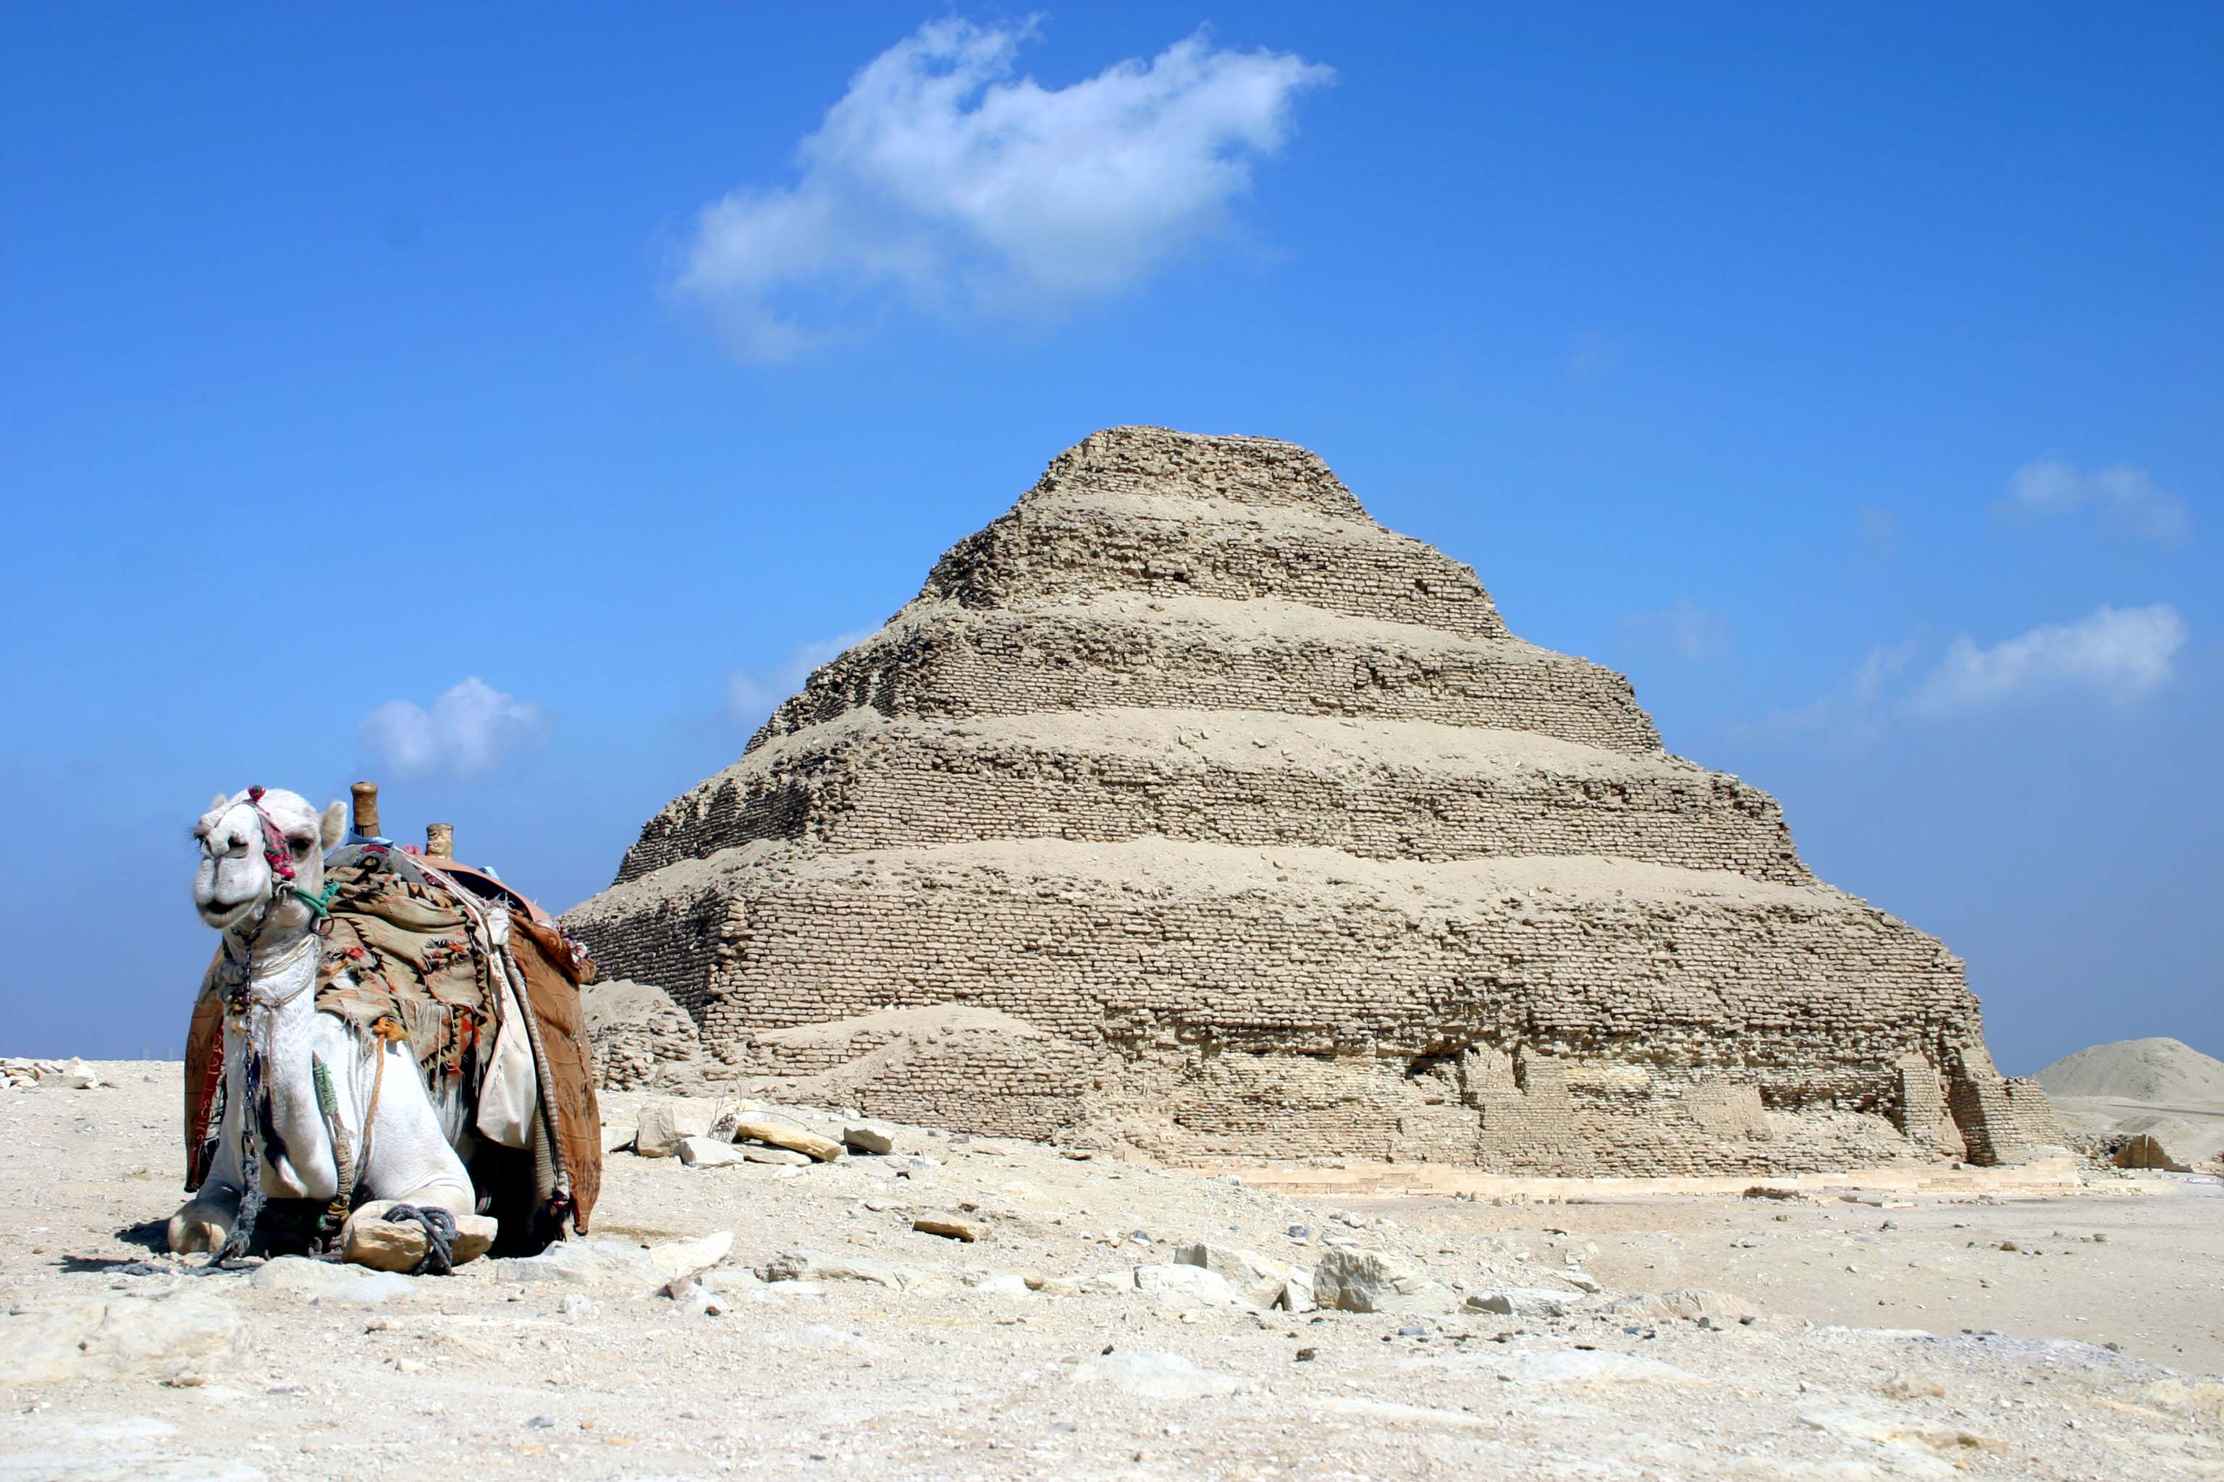
Early Dynastic Period (c. 3100–2686 BCE)
Dynasties: 1st and 2nd
Characteristics: Unification of Upper and Lower Egypt under the first pharaoh, Narmer.
Key Developments: Centralization of political power, development of writing (hieroglyphics), and construction of early mastabas (tomb structures).

Slide 9
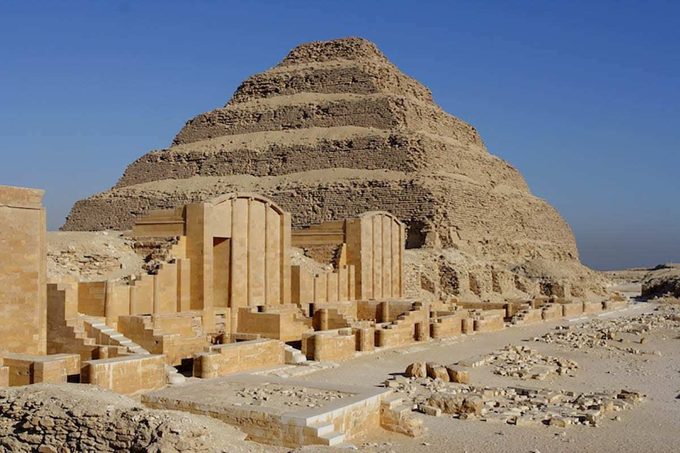
Old Kingdom (c. 2686–2181 BCE)
Dynasties: 3rd to 6th
Characteristics: Age of pyramid-building, including the Great Pyramid of Giza.
Key Developments: Strong centralized government, advances in art and architecture, and the development of a complex religious system centered around the sun god Ra.

Slide 10
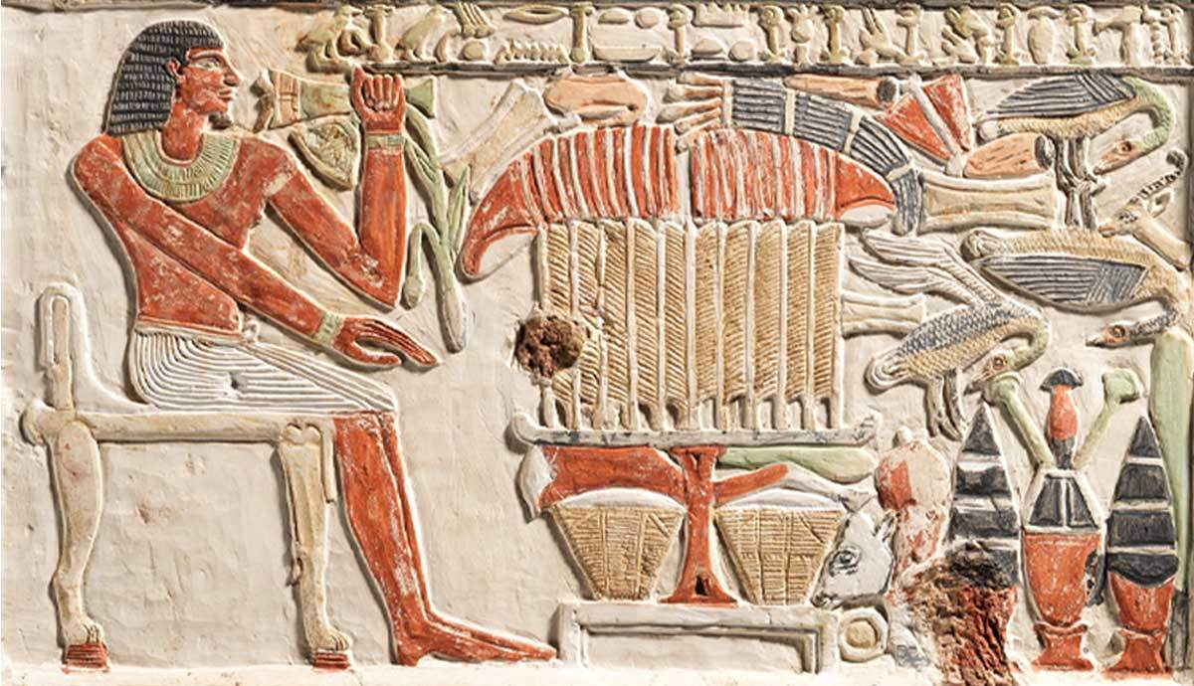
First Intermediate Period (c. 2181–2055 BCE)
Dynasties: 7th to 11th (early part)
Characteristics: Period of political fragmentation and social upheaval.
Key Developments: Decline in central authority, regional rulers (nomarchs) gain power, and reduced monumental building activities.

Slide 11
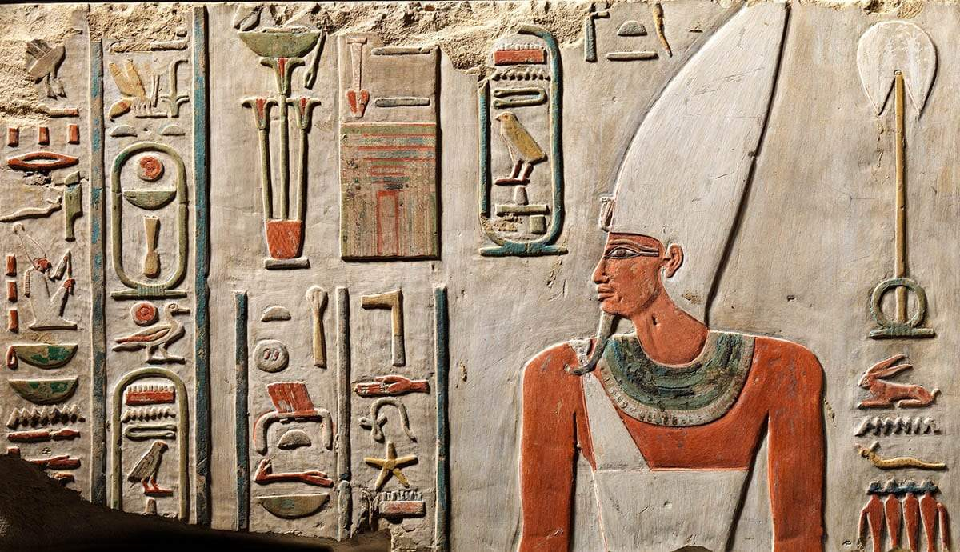
Middle Kingdom (c. 2055–1650 BCE)
Dynasties: 11th (late part) to 13th
Characteristics: Reunification of Egypt under strong pharaohs like Mentuhotep II.
Key Developments: Revival of art, literature, and monumental building; expansion of trade; and military campaigns into Nubia.

Slide 12
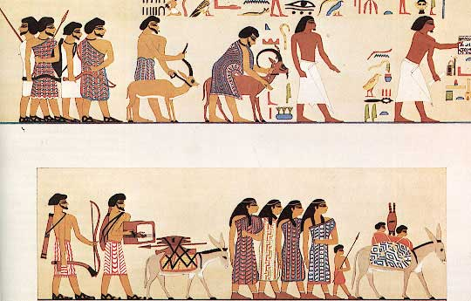
Second Intermediate Period (c. 1650–1550 BCE)
Dynasties: 14th to 17th
Characteristics: Another period of political instability, with the Hyksos, a foreign Semitic people, ruling parts of Egypt.
Key Developments: Introduction of new technologies, such as horse-drawn chariots and new forms of weaponry, due to Hyksos influence.

Slide 13
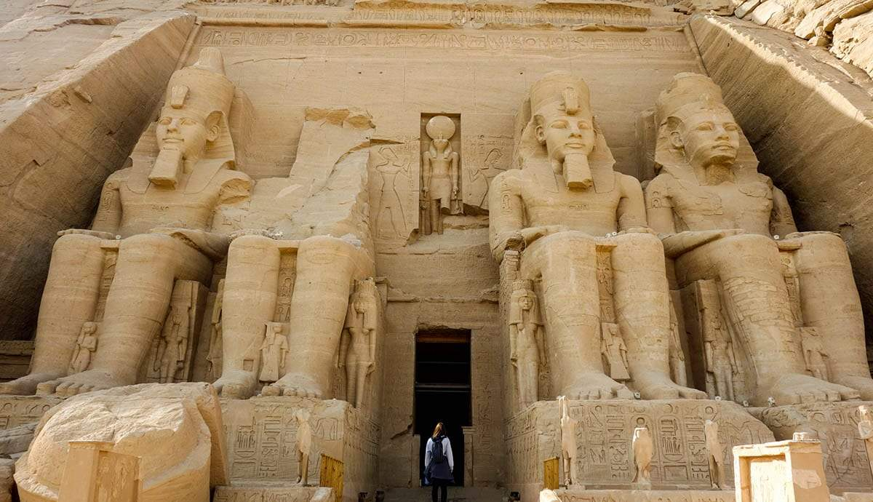
New Kingdom (c. 1550–1077 BCE)
Dynasties: 18th to 20th
Characteristics: Egypt becomes a major international power, marked by extensive building projects and military conquests.
Key Developments: Construction of famous temples (e.g., Karnak and Luxor), reign of powerful pharaohs like Hatshepsut, Akhenaten, and Ramesses II, and the temporary monotheistic worship of Aten under Akhenaten.

Slide 14
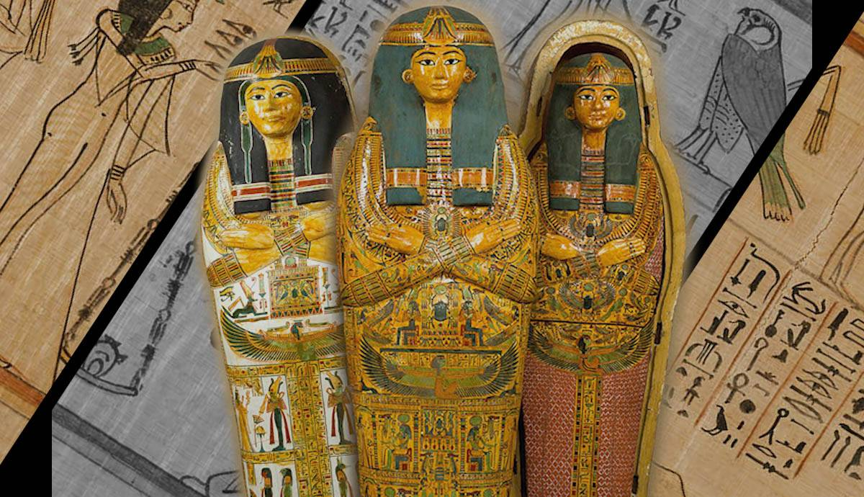
Third Intermediate Period (c. 1077–664 BCE)
Dynasties: 21st to 25th
Characteristics: Period of political fragmentation and declining central authority.
Key Developments: Division of Egypt into several power centers, increasing influence of Libyan and Nubian rulers, and the eventual conquest by the Assyrians.

Slide 15
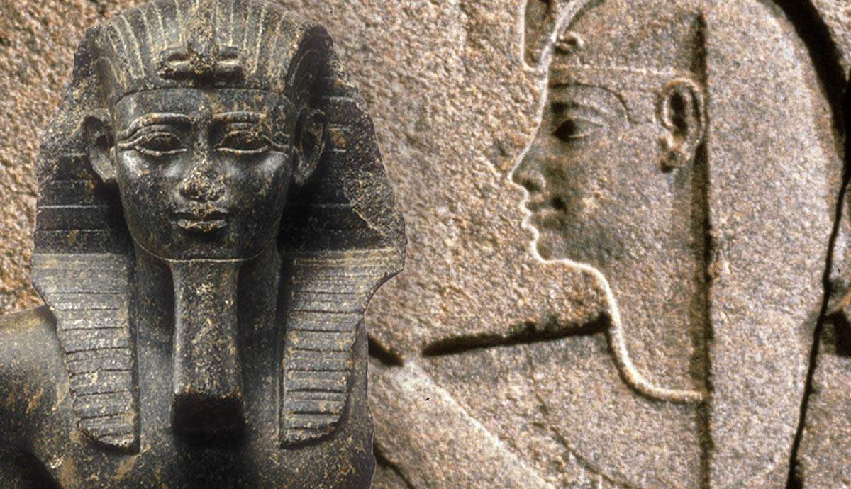
Late Period (c. 664–332 BCE)
Dynasties: 26th to 31st
Characteristics: A revival of central authority and a cultural renaissance, followed by periods of foreign domination.
Key Developments: Saite Dynasty's efforts to restore Egyptian traditions, Persian conquest, and eventual incorporation into the Persian Empire.

Slide 16
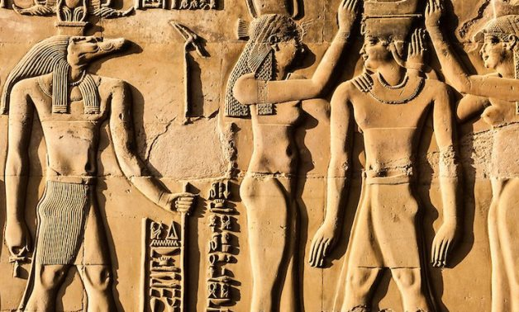
Ptolemaic Period (332–30 BCE)
Characteristics: Greek rule following Alexander the Great's conquest, establishment of the Ptolemaic Dynasty.
Key Developments: Fusion of Greek and Egyptian cultures, construction of new temples, and the famous reign of Cleopatra VII.

Slide 17
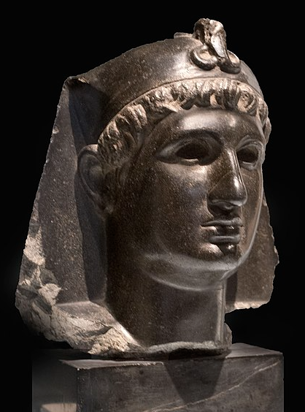
Roman Period (30 BCE–395 CE)
Characteristics: Egypt becomes a province of the Roman Empire after Cleopatra VII's defeat.
Key Developments: Continued blending of cultures, spread of Christianity, and gradual decline of traditional Egyptian religious practices.

Slide 18
Watch the following:
https://www.youtube.com/watch?v=vUA3MbqdkDI&ab_channel=CaptivatingHistory

